Slide 1
Update on the Boston Spa BEET Voltage Optimisation Project
Presentation to U3A Climate Matters Group
Friday 26th June 2026.
Keith Jackson (Resident and instigator)
Notes:
Title page. Are YOU really interested in Voltage?? There is a sub plot or personal story which may be interesting to some.

Slide 2
My story
Long career in Electricity Industry around UK
Career experience of historic low voltage problems
Found excess voltage on my Solar PV
Explored reasons for high voltage
Challenged OFGEM and my local Distribution Network Operator
Developed solution on behalf of customers and Planet
Now pressing for UK roll out

Slide 3
Notes:
Your personal reaction to this situation?
Wasteful?
Careless?
What if all pumps are leaking (not an isolated error)?

Slide 4
Notes:
But it is universal!
The PRESSURE is too high.
The Electricity companies are being paid by the unsuspecting customers!
This version gathered their attention when I explained their lack of moral code.
Who is paying? (Customer and environment). Privatised companies are not customer friendly!

Slide 5
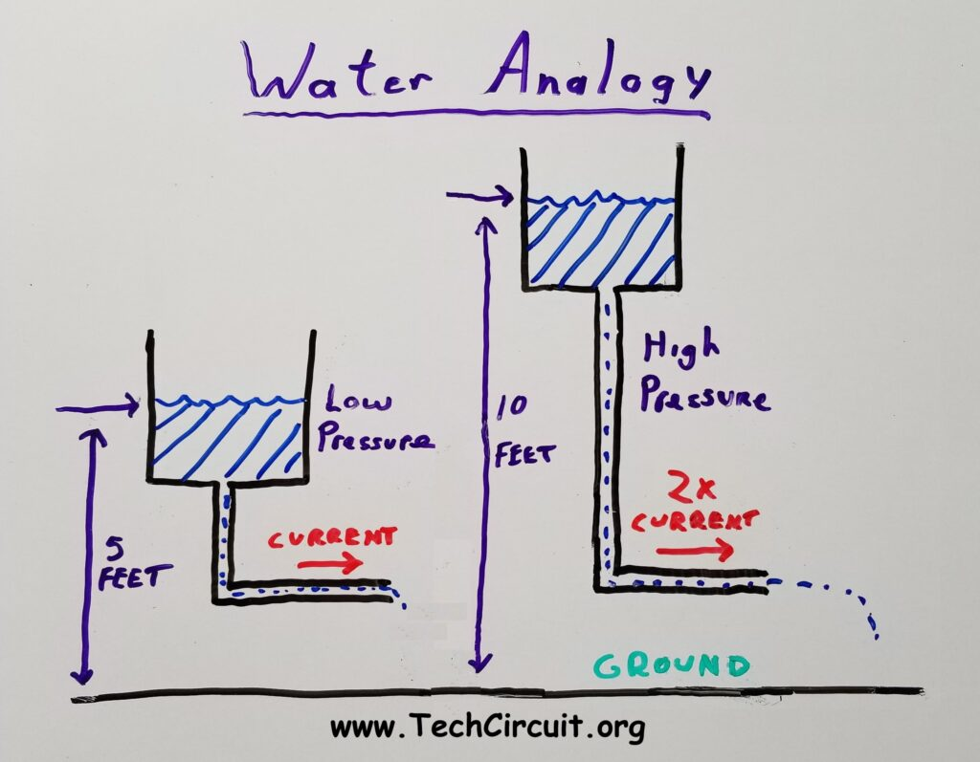
What is Voltage?
Notes:
Higher pressure (voltage) pushes more water (electricity) through pipe

Slide 6
What is the BIG Idea?
Voltage has been too high and wastes electricity.
By Controlling Voltage (mostly downwards) it will :-
Reduce Electricity Bills
Reduce Carbon Emissions
Release Capacity on the Electricity Network
Notes:
Describe how I found out that voltage has been too high.
Solar error message/check with recording device/ask why high?/get NPg to change voltage in local substation/investigate regulations/Neighbourhood Plan policy/realisation that smart meters are voltage meters and can be used to measure and manage

Slide 7
Why hasn’t it been done before?
Industry Traditional Habit. “We’ve always done it that way”.
Central Generation (CEGB) was normal. Now it is decentralised.
Harmonisation of voltage across Europe in 1993 (but UK ignored).
Privatisation changed behaviour in favour of shareholders.
Weak Regulation by OFGEM – no incentive.
Notes:
What is the standard voltage in UK? 220/230/240V
Common voltage after we joined EU so equipment suitable for whole market.
Special pleading by UK for +10% = 253V

Slide 8
Can it be True?
Proven Academic and Industry studies.
Industry established method to reduce load under Emergency
Private Industry experience – many factories employ VO.
Notes:
Induction load on motors. Excess voltage causes extra unwanted heat (lighting, transformers and inverters).
Voltage reduction in bad winters and miners’ strikes as first stage saving - before rota cuts.
Large industry uses Voltage Optimisation as energy and cost saving.
I have a 15V step down transformer (cost £500)

Slide 9
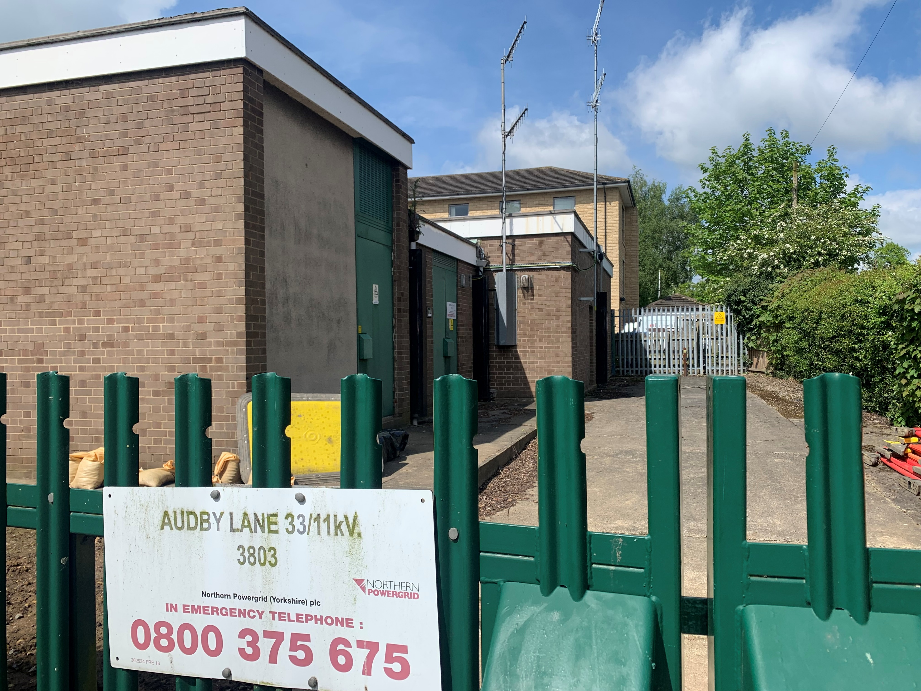
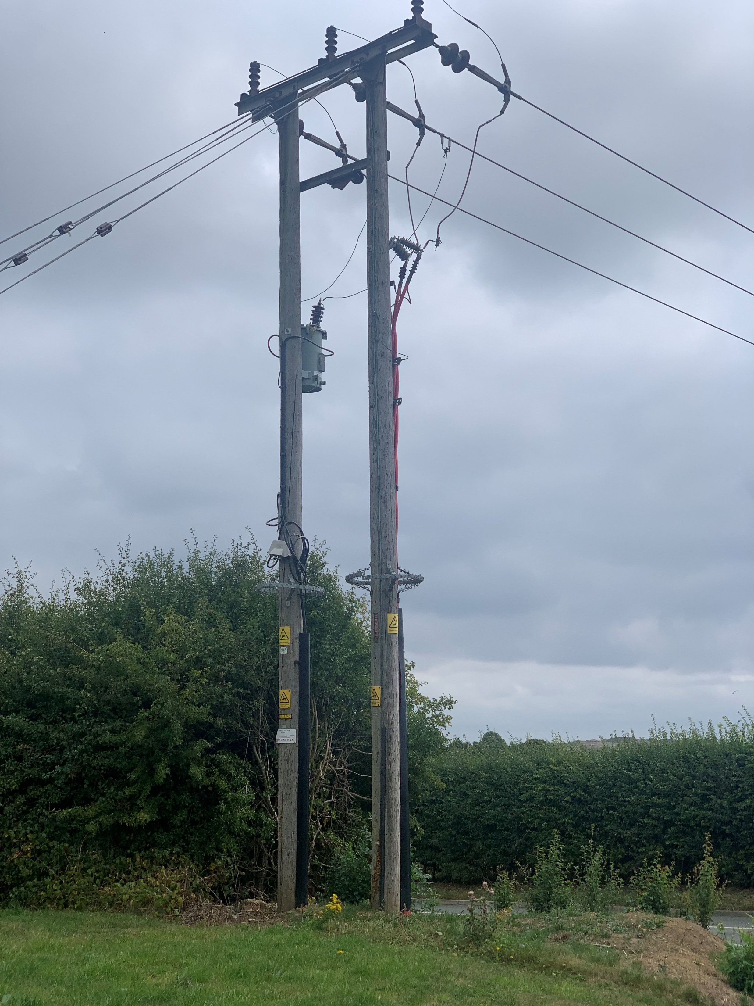
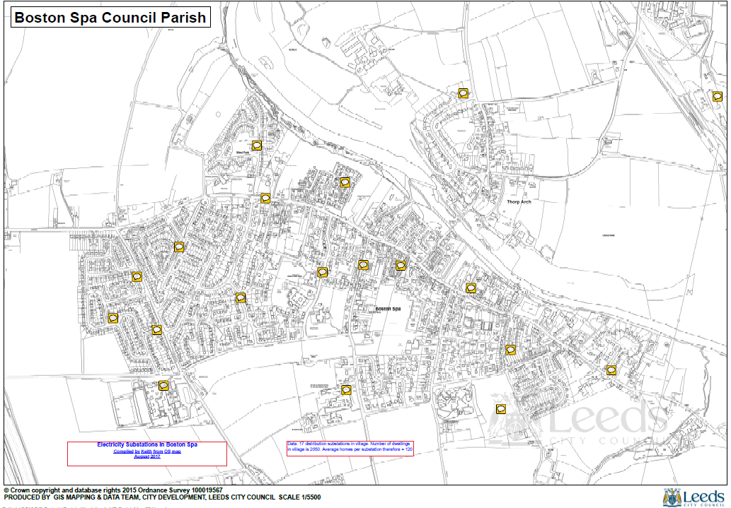
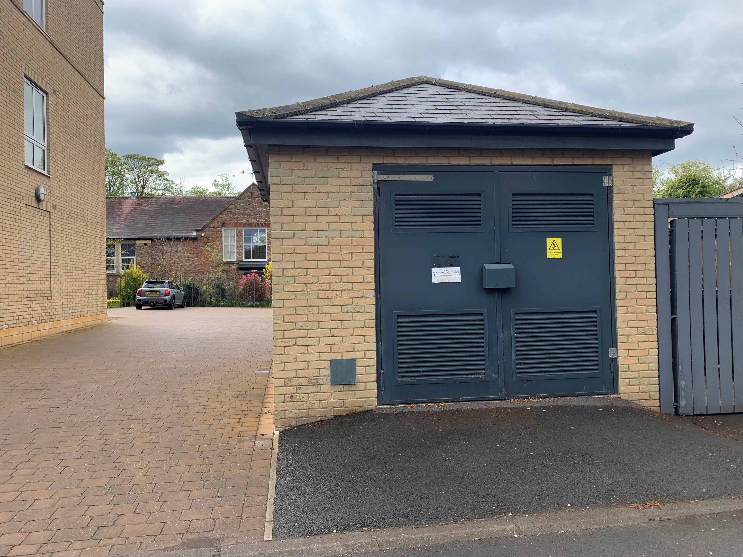
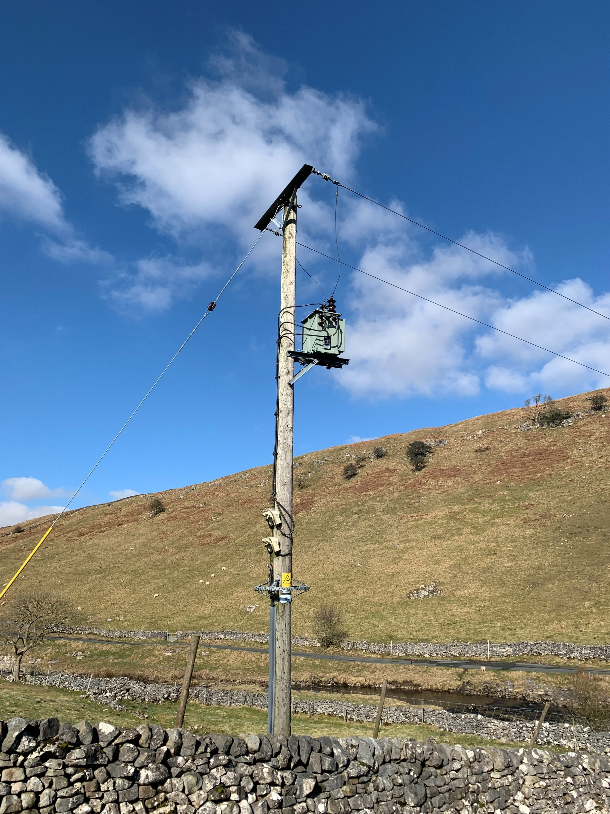
Local Electricity Network
Notes:
Let me describe how electricity gets to your home or shop or church.
My story today starts when I was an apprentice in East Midlands Electricity Board (EMEB) at the age of 16yrs.
Describe this network in Boston Spa. (refer to 11kV from Primary S/S, and link boxes in pavements)
Learned about voltage and things/wired houses/laid cables and put up overhead lines/designed networks/operated networks/visited customers when they complained about VOLTAGE.
But in the 1960’s voltage was invariably low. I checked using an ink trace on a paper drum which was connected to a customer meter for 2 weeks. Note: NEVER a high voltage.

Slide 10
The Light bulb moment
Use the voltage readings from Smart Meters
Regulate the voltage in real time
Notes:
Neighbourhood Plan idea to adjust local transformers (say 30%) – found that problem was universal.

Slide 11
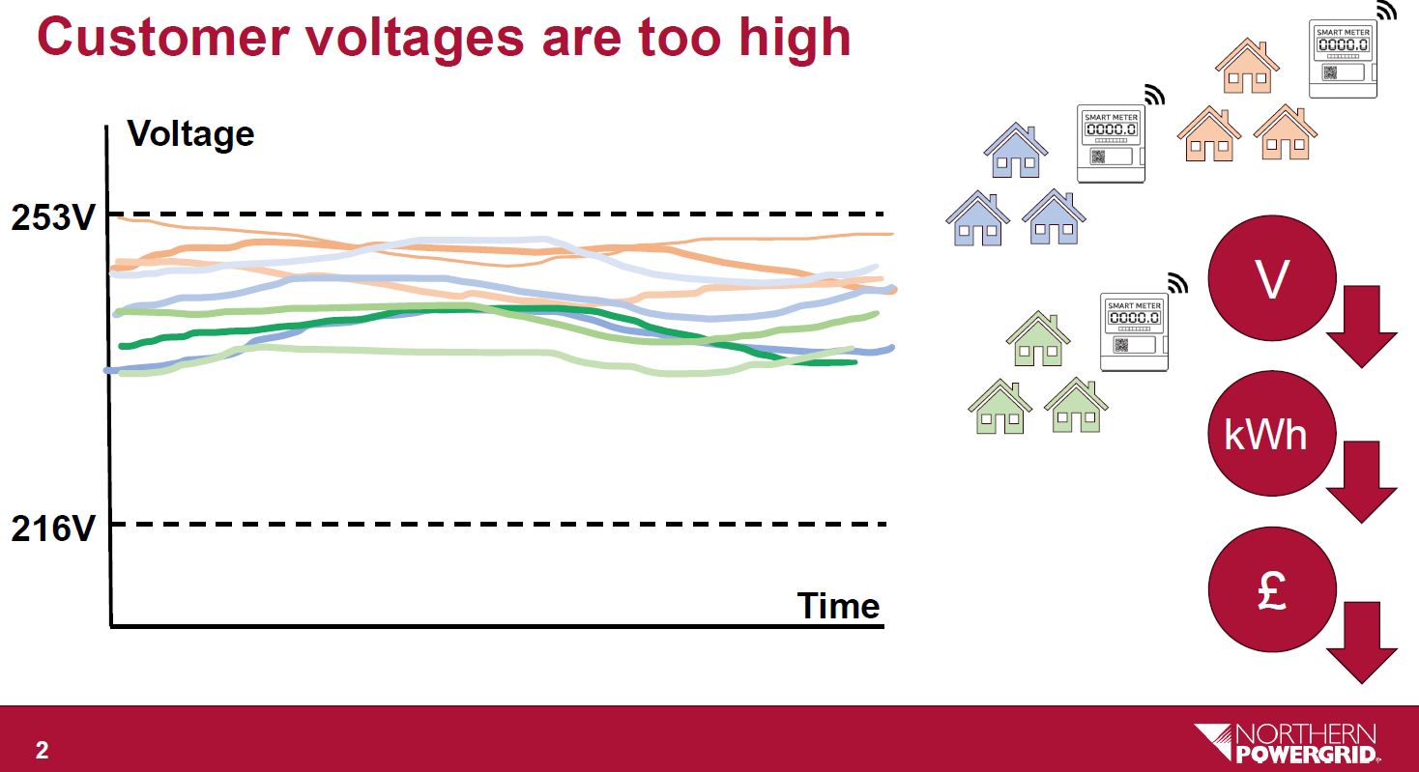
Voltages Prior to BEET
Notes:
Once NPg were engaged in the potential problem I asked for sample voltage details from Smart Meters.

Slide 12
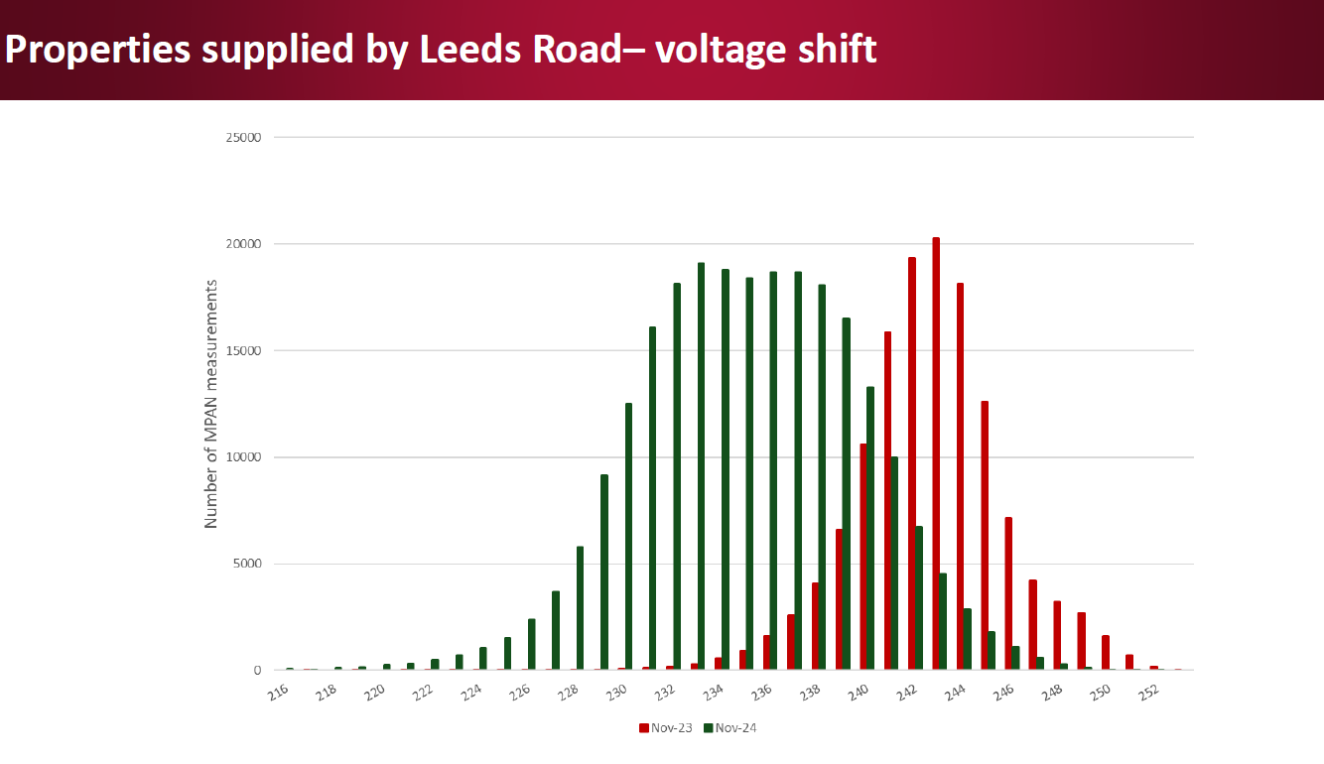
How Voltage has been Reduced
(Nov 2023 to Nov 2024)
Notes:
Data from Leeds Road, Collingham. Shows how BEET has moved the whole curve to the left by 10V (approx. 4%)
Notice that originally, some customers had statutory OVER VOLTAGE.

Slide 13
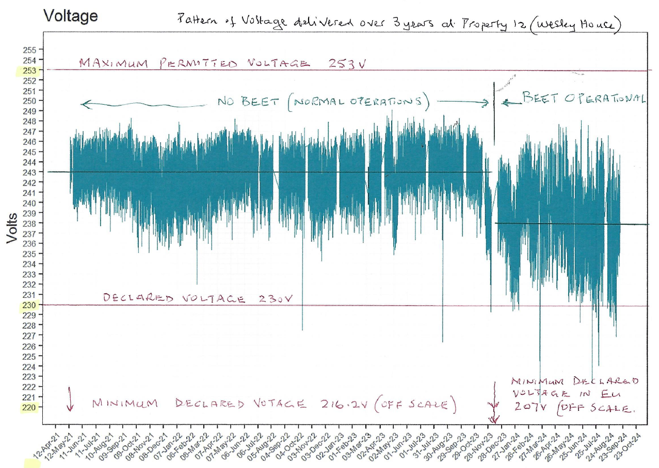
The Scope for Voltage Improvement
Notes:
BEET operational from Jan 2024 (Cautious). Reduction from mean 243V to 237V (6V = 2.5%).
Note that there is an additional drop of 15V with my own transformer (hence circa 222V actual )

Slide 14
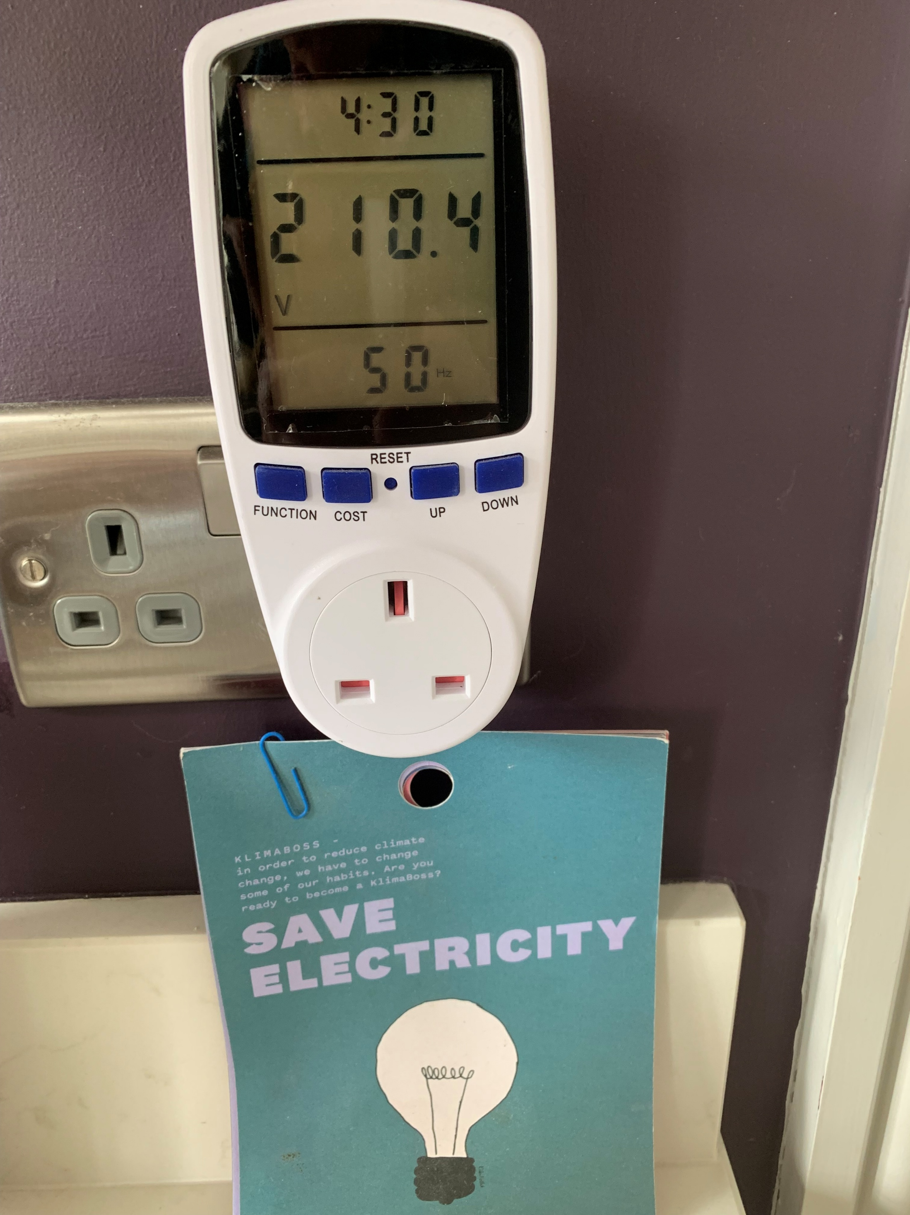
Lower Voltage is Risk Free
(Snapshot of typical volts at Wesley House)
Notes:
Usable voltage after reduction from my transformer (ie 15V lower than delivered voltage).
No problems over 10 years including 2+ years of BEET.

Slide 15
BEET Territory
Properties fed from Primary Substations:
Audby Lane Wetherby
Leeds Road Collingham.
Warren Lane Tadcaster.
Places Benefiting:
Wetherby
Kirk Deighton
Walshford
Tockwith
Walton
Clifford
Bramham
Collingham
Bardsey
Wike
Notes:
Map of BEET application geography

Slide 16
What Next?
Wetherby – Benefits secured so sit back and ENJOY.
Yorkshire and the North East – 5 year rollout programme by NPg.
Across UK – Work in hand to persuade (some reluctance).
Notes:
£400k per year (Wetherby area). 4 million properties in NPg by 2033.
Possible to reduce voltage by a further 4% (in addition to BEET). EU already operate down to 207V (NB The UK is 216V)

Slide 17
ENA Consultation for UK
        Engineering for the Future Modernising statutory voltage limits
        consultation January 2026 average of 243 V to a value closer to 230 V.
        There are potential issues caused by this and pragmatism is required to make a balanced decision.
        This consultation highlights the key benefits and key issues, where on balance, the net benefits are estimated to reduce long-term costs by billions of pounds whilst better facilitating the energy transition.
        3 Proposal
        The proposal is to change the lower bound of the low voltage statutory voltage limits from -6% (216.2 V) to -10% (207 V). This would allow networks to be operated within a wider range of voltages, enable customers to connect more generation and more demand (including devices such as electric vehicles and heat pumps). Fewer barriers will result in lower cost and faster timescales for customers. Products manufactured since 1995, when the UK harmonised with European standards, have been designed to this wider voltage range. The proposal is to then implement a 1% voltage reduction in the first year and then monitor and assess the impact (including the potential issues outlined in this report). This will be followed by a further reduction of 1% in the second year where acceptable. This would result in a 2% voltage reduction overall (generally applied on the 11 kV network, therefore impacting both the 11 kV network and the downstream LV network). Currently, customers receive an average voltage of 243 V. Therefore, this proposal would reduce the average voltage to 238 V (an average reduction of 5 V). This still exceeds the declared voltage for which appliances were designed to operate at, whilst being significantly above the lower limit.
(Extract from current ENA consultation)
Notes:
Active consultation NOW!
Industry is keen. Mostly(?) because it will give them more flexibility and will save capital expenditure.
ENA is representative body for UK Distribution companies.
Ambition is to get DESNEZ to buy in to idea in 2026.

Slide 18
Open Discussion
Your opportunity to get more information………..
How…..? What if……? Who pays….?
Why…….? But……?
When……..? Have you………..? I think………..?
Notes:
Your opportunity to ask questions and challenge.

Slide 19
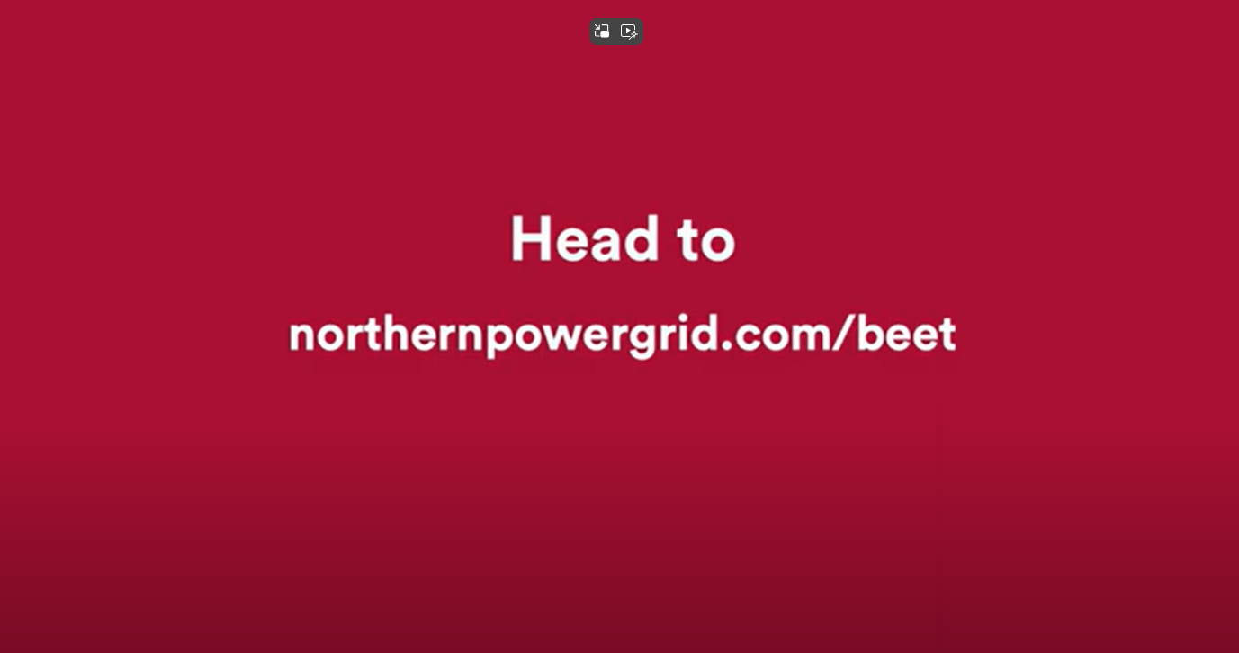
A Quick Video Introduction to BEET
Notes:
Link to NPg web site: Northernpowergrid.com/beet
Let’s take a quick look at how Northern Powergrid have presented it.
£440k across Wetherby Area. (Individual household = £30pa + 20kg co2)
PS Northern Powergrid is the company who took over the role of YEB and NEEB (for the oldies in the room)
Show video.

Slide 20
Thanks for Listening and Engaging
Want More Information?
Link to Northern Powergrid :
northernpowergrid.com/beet
Local contact:
Keith Jackson
email: khj@ntlworld.com
Telephone: 01937 522536

Slide 22
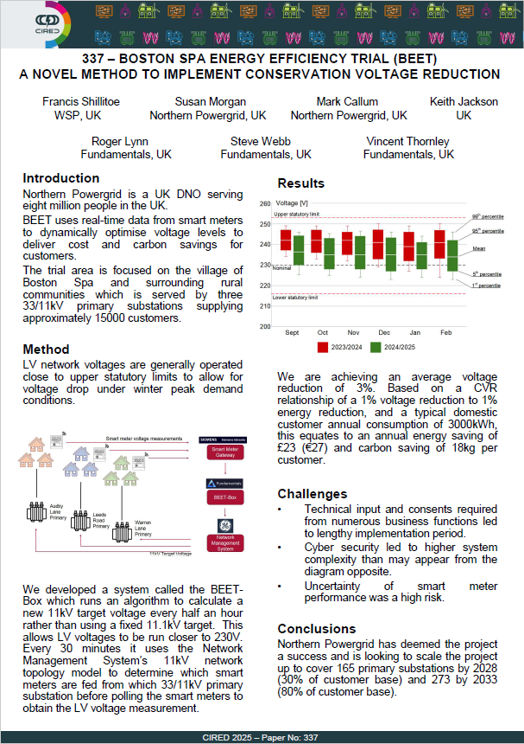
International exposure in 2025
Notes:
Topic presented to International conference in Geneva.

