Slide 1
Air to Air and Air-Sourced Heat Pump (ASHP)
Helen Howard

Slide 2
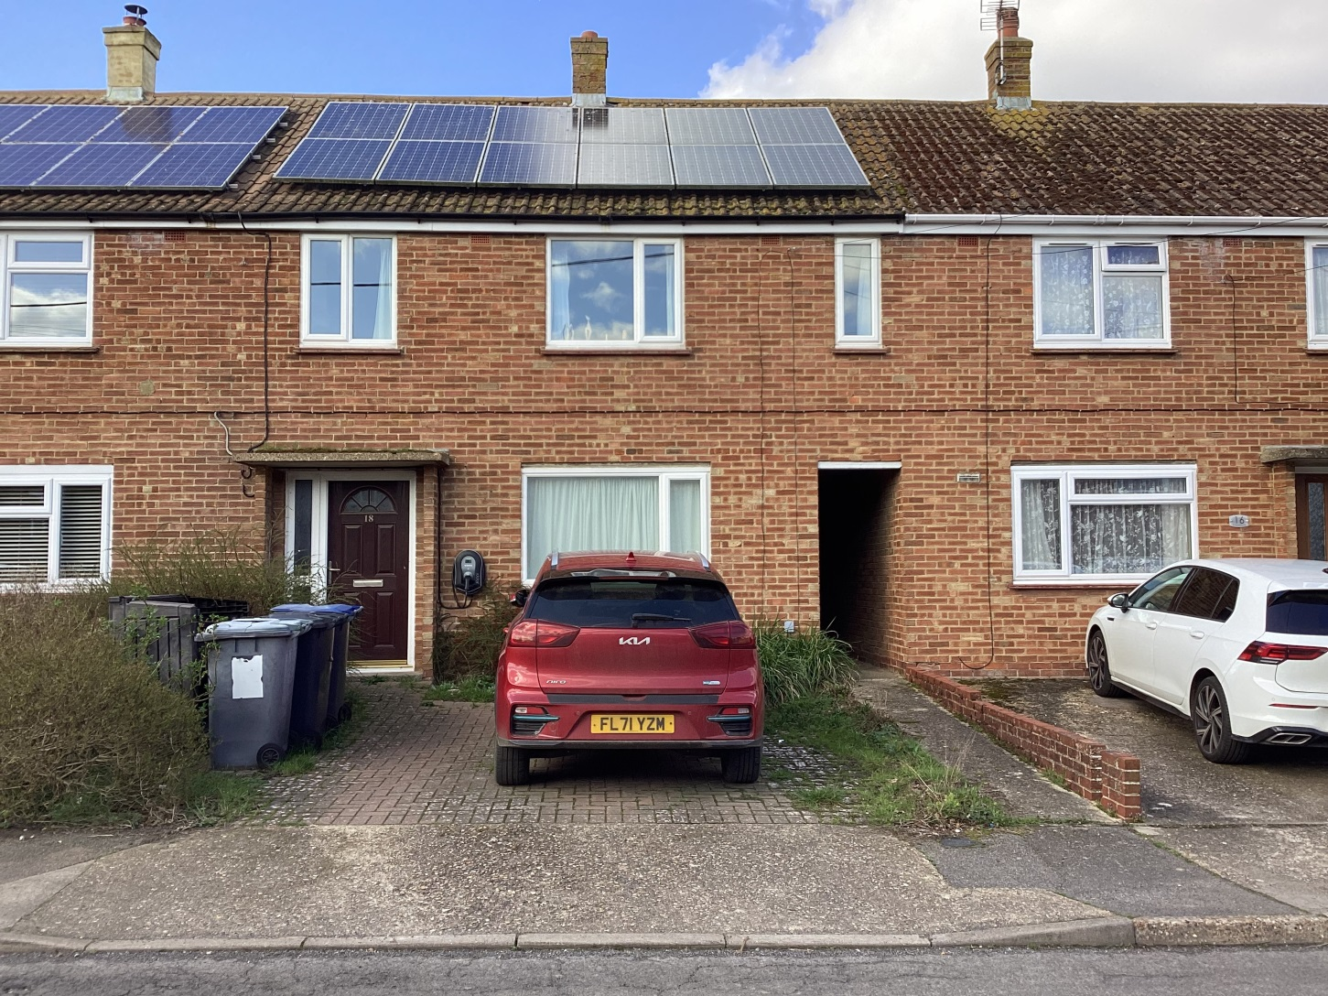
1955 3 bed mid terrace

Slide 3
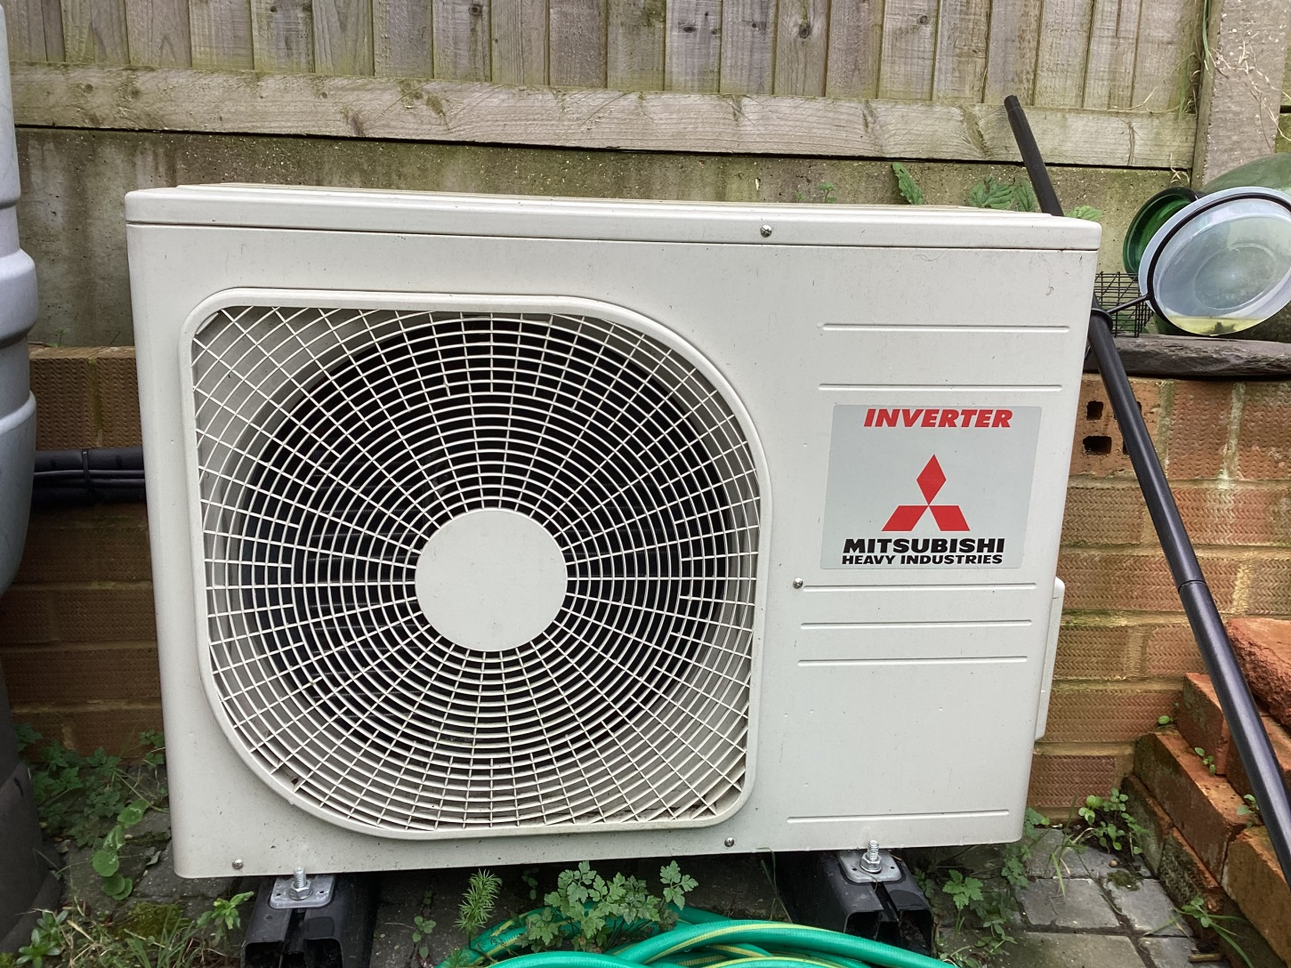
Air to air outdoor unit

Slide 4
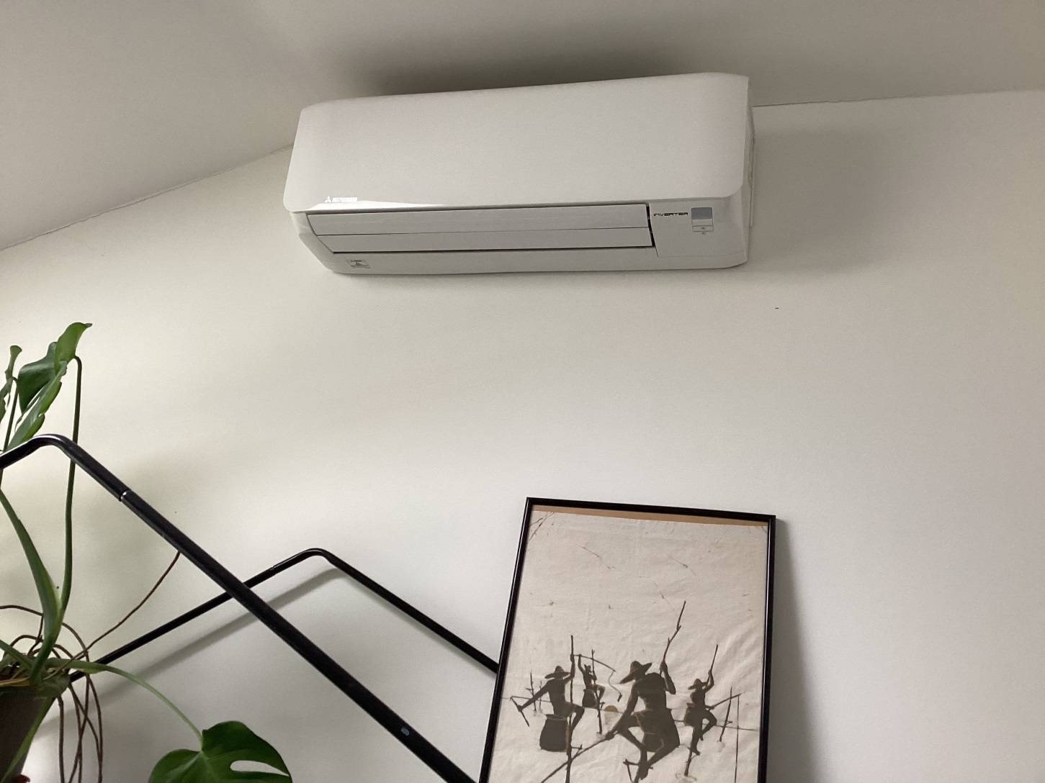
Air to air indoor unit

Slide 5
Air to air investment
Installation to family room which has high ceiling 01 November 2023 £1,680
One day’s work
Annual maintenance £96
takes a couple of hours
Reason for purchase to test out how much heat I needed with gas switched off.
Can heat or cool – quick acting
Unobtrusive and very cheap to run

Slide 6
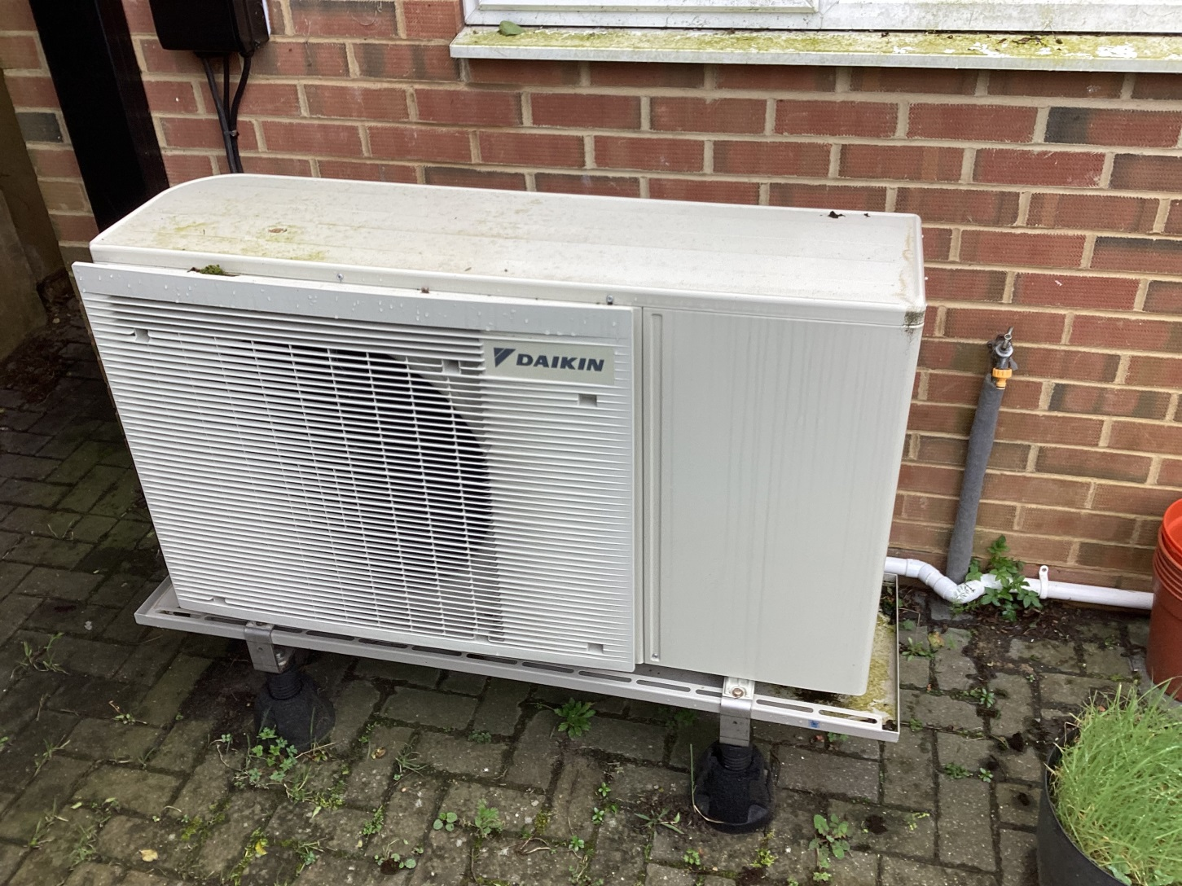
ASHP outdoor unit Daikin

Slide 7
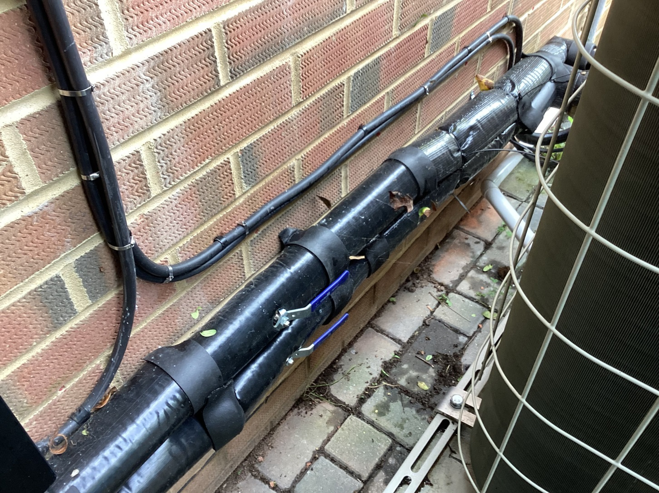
ASHP pipework behind unit

Slide 8
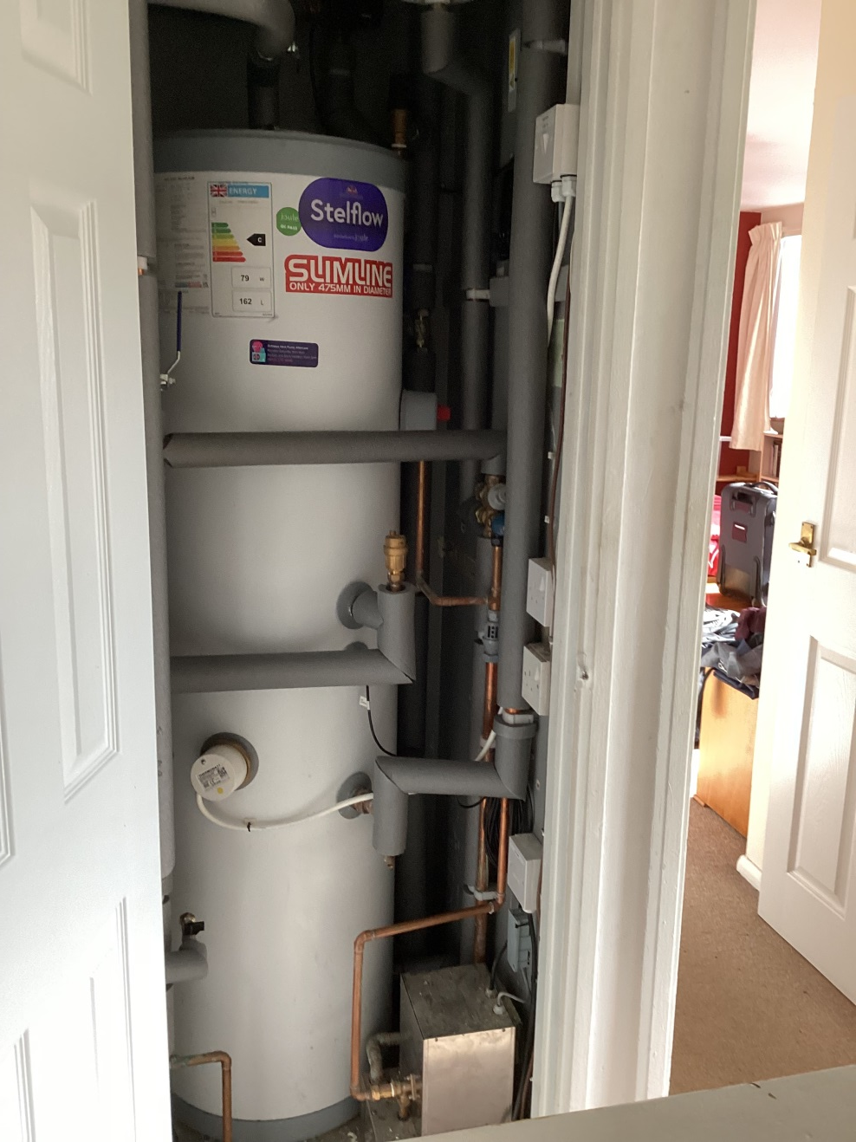
ASHP hot water tank

Slide 9
ASHP investment etc
15 August 2025 installation
£15,730 less £7,500 grant and £300 discount
= £7,930 of which £2,500 cost of changing microbore piping and 5 radiators
2 weeks work by Octopus
Post-installation: excellent follow-up support
There will be annual maintenance cost
Slow acting; I keep it switched on all the time
It is unusual for indoor temp to drop below 16C

Slide 10
Total Energy low running costs
January 2026 bill £72.43
February 2026 bill £65.62
March 2026 bill £33.68
Tariff: Intelligent Octopus Go for car charger
6.67p per unit for 6 hrs at night 11.30 to 5.30
to charge car and fill batteries, used to run the house all day including heating
(free solar energy when the sky is light)

Slide 11
Ground Source Heat Pump and Air to Air Heat Pump
Nick Ward

Slide 12
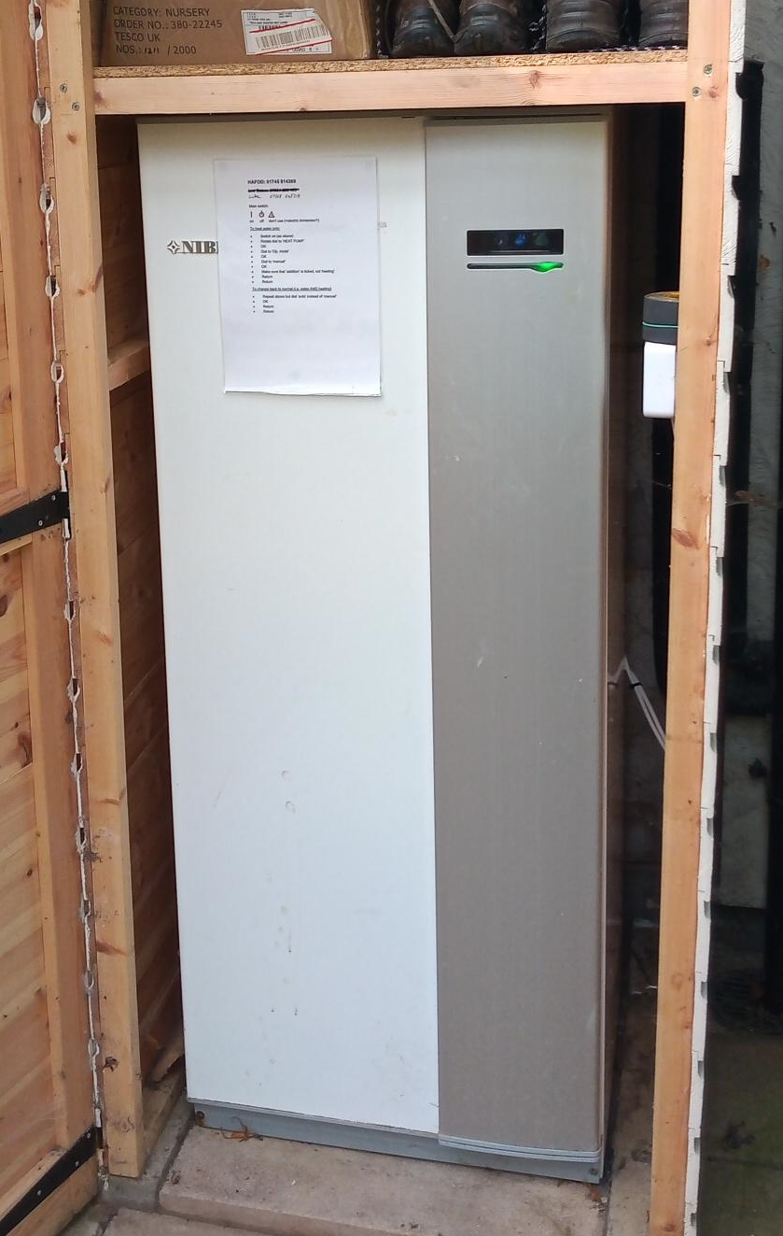
12kw NIBE ground source heat pump
Installed summer 2017
Replaced oil boiler (no mains gas)
£19k in total
This included £1800 for 500m trench
RHI has more than covered the cost
Heats water as well as radiators
Used October to April
In summer, PV heats water

Slide 13
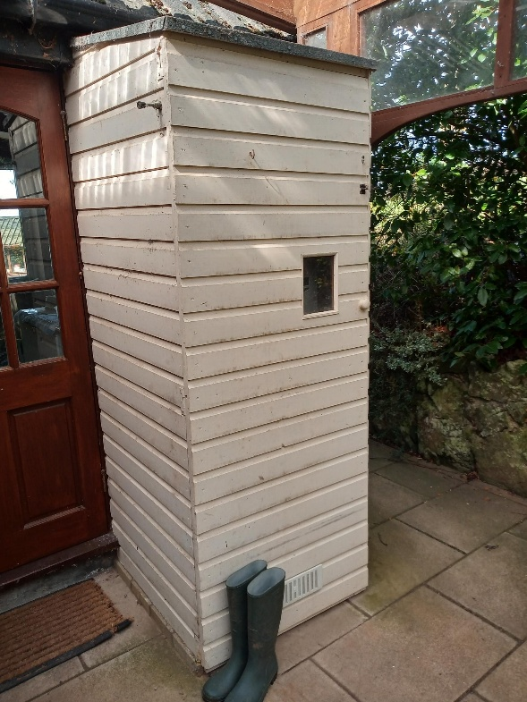

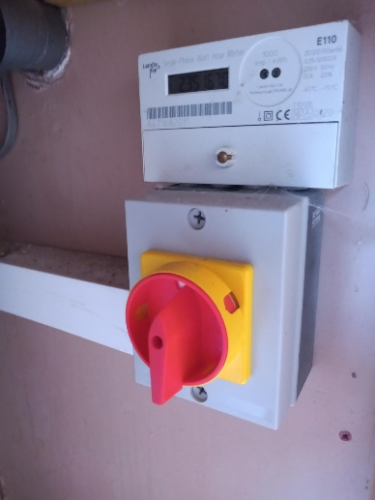
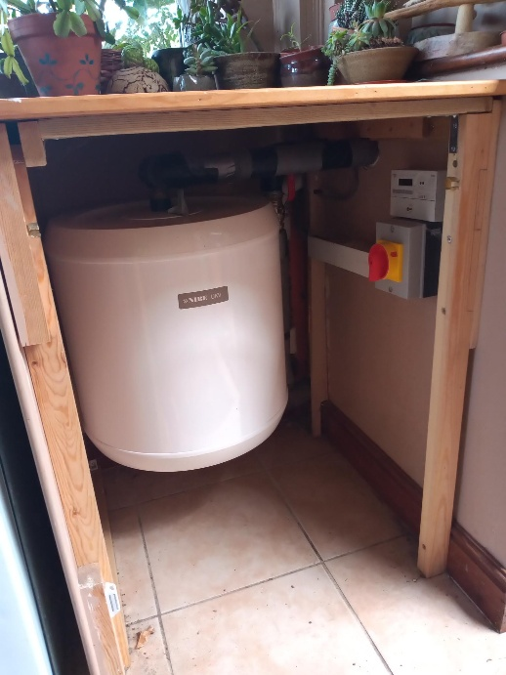
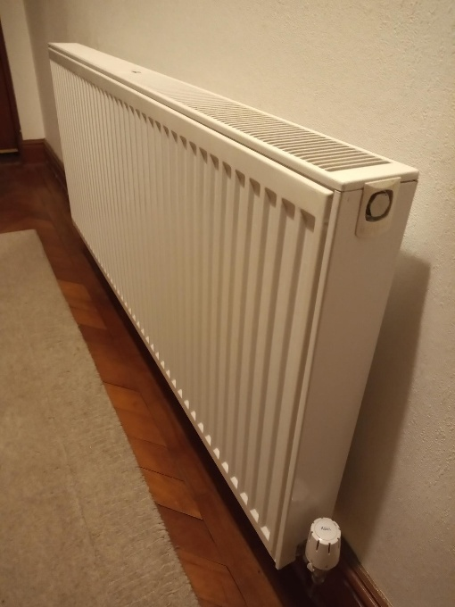
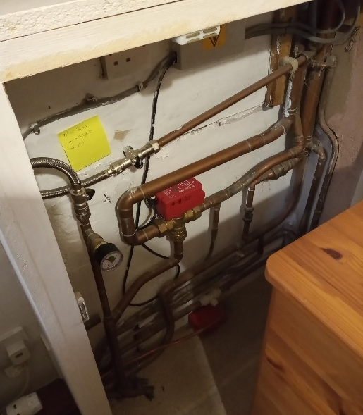
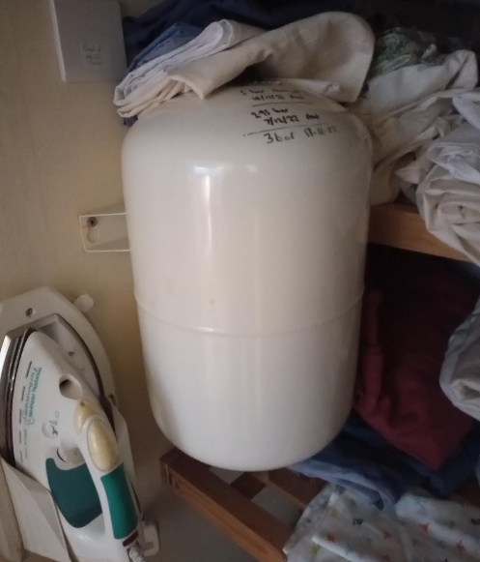
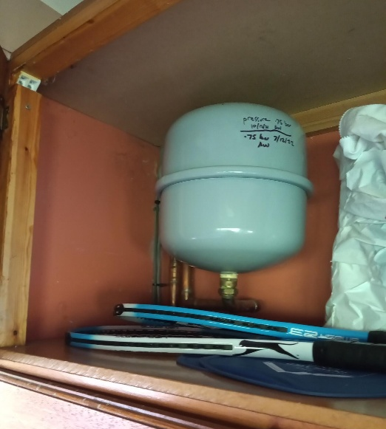

Slide 14
Some issues
… Fitting it all in!
Had some problems shortly after 7-year warranty expired
Finding competent (and competitive) service engineers
Is annual servicing really needed?
Yes for warranty
Thereafter??
Negotiated discounted price for group servicing
Currently £175 for Air Source and £200 for Ground Source.
cf for single installations: £220 for Air Source and £250 for Ground Source

Slide 15
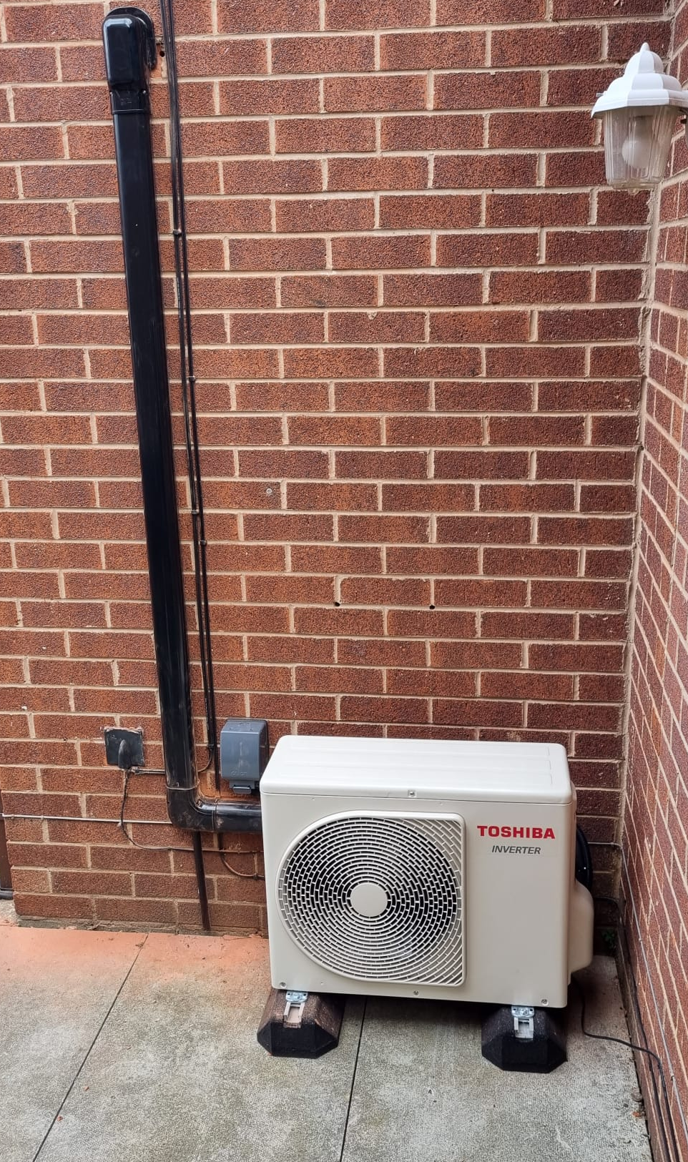
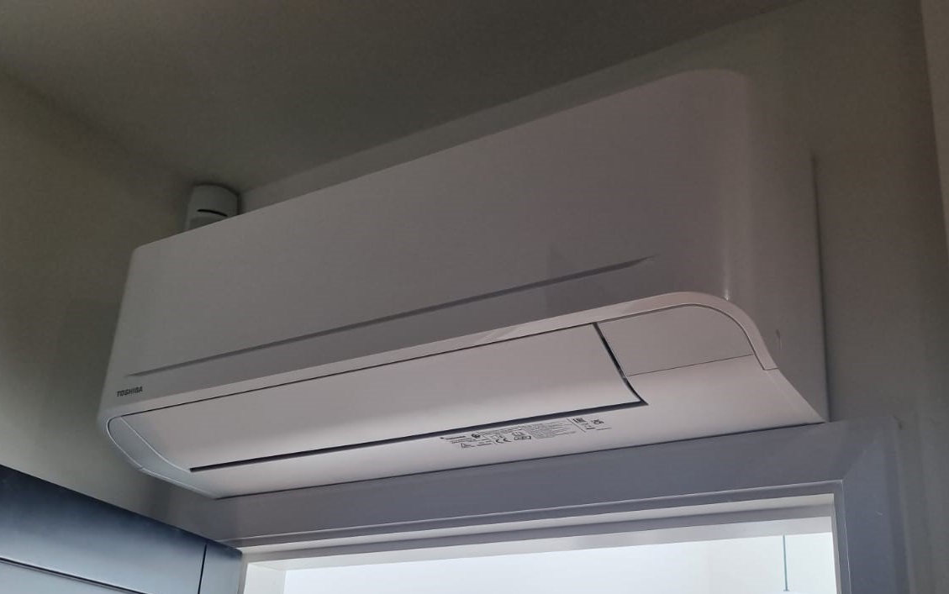
Adding Air to Air for an extension: - avoids more internal plumbing - rapid heating - runs off 13 amp socket

Slide 16
Heat Pump for a New Build
Ruth Winterbottom

Slide 17
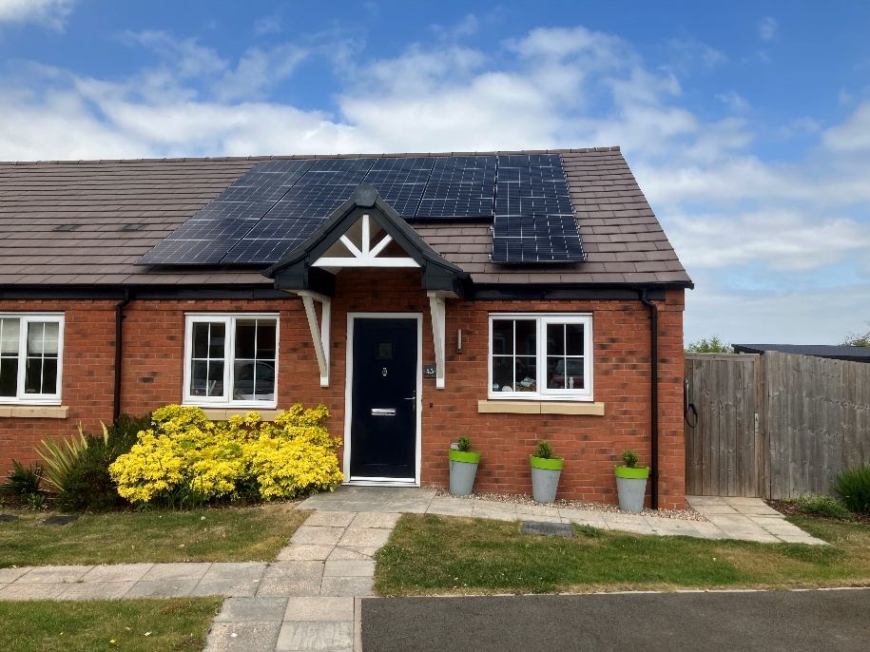
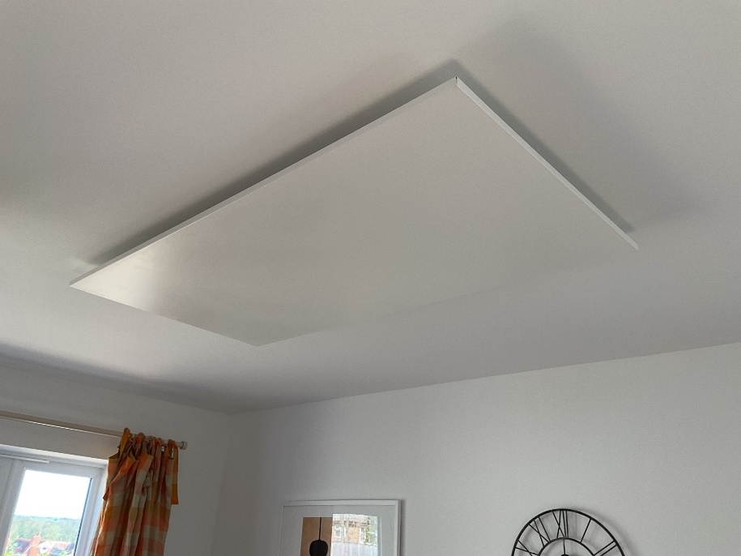
New build 2 bedroom semi-detached bungalow, 2022
5.5kw solar array, 12.8kwh battery storage
Wanted an air-to-water heat pump, refused by everyone we approached, locally or nationally - air-to-air not mentioned by anyone at the time.
In order to go completely electric, we opted for ceiling-mounted infra-red panels.
Because of favourable tariffs/solar panels/batteries, 2025-26 bills £200

Slide 18
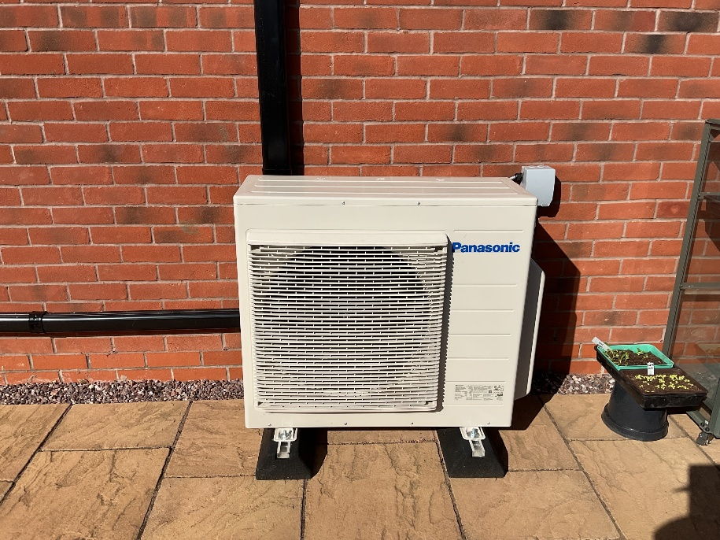
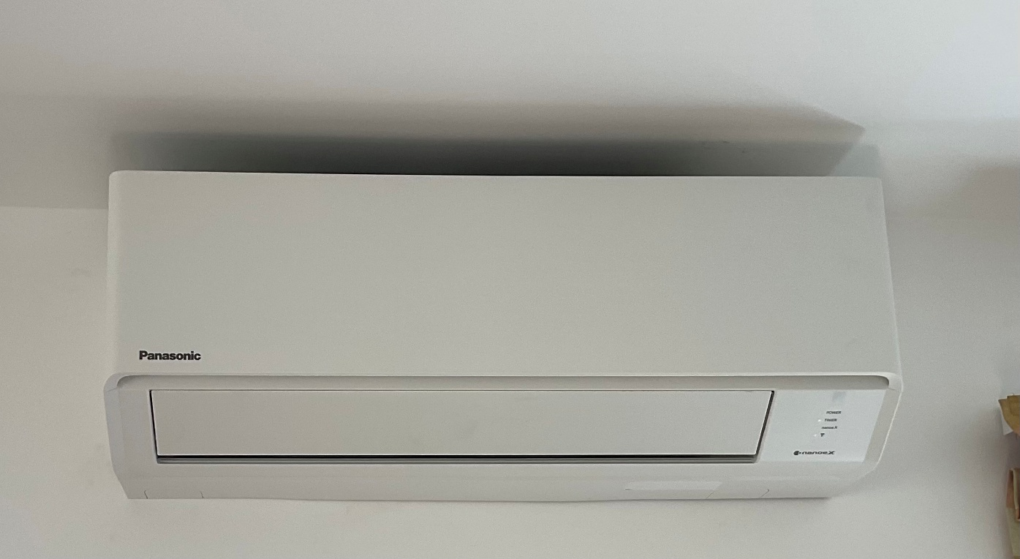
Hottest days in summer overheated south-facing kitchen and workroom (bedroom 2) so thinking of heat pump air conditioning (air-to-air)
Fitted in February 2026, kWh usage falling already!

