Slide 1
Uk Electricity Bills.
What are they made of?

Slide 2
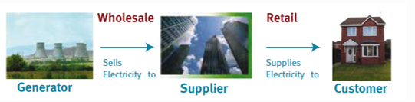


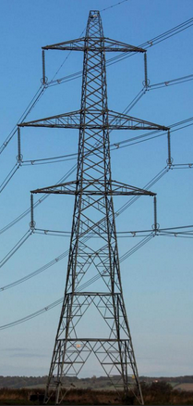
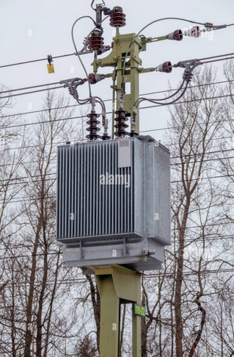
The main players in the cost of supply
Sells
Costs
Supergrid Transmission
Local Distribution
Controlled by NESO/DNO

Slide 3
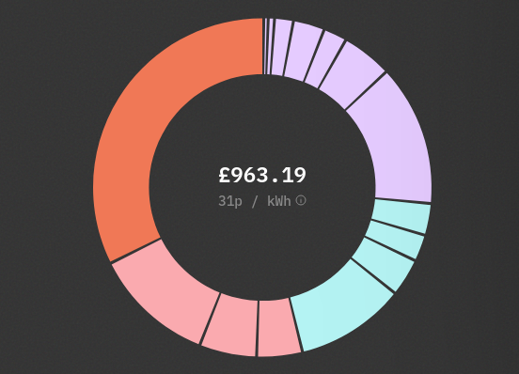
The Core Components of a Bill
Wholesale
to Grid
VAT
2025
Supplier own costs & Margin
Delivery
via grid
https://www.electricitybills.uk/?utm_source=substack&utm_medium=email

Slide 4

Approximate timeline of the wholesale Electricity Prices
Typically many 10s of years
Up to 3 years before supply
8am to 11am the day before
From 11 am the day before
1hr before supply
‘Finance’ of construction of necessary infrastructure.
‘Over the Counter Trades’ between sellers and buyers.
‘Day Ahead Auction’ sets wholesale clearing prices.
‘Intra-day Market’ begins
Gate closure NESO determines ‘STOR’
Metering reconciliation
Final payment settlements up to 14 months after supply.
£
N
Notes:
Finance costs are in the prices of all electricity trades
Over the counter trades. Provide about half the total supply
Day ahead auction. Provides about 40% of total supply.
Intra-day market begins 11am the day before supply
Continues up to 1 minute before supply
Expensive electricity but provides only a small % of total supply.
1hr before supply gate closure
NESO determines what balancing actions are required to finally match supply and demand and the size of short term operating reserve (STOR) required.
A day ahead auction has determined the prices available to NESO.
Generators must be able to deliver at 20 minutes notice and maintain supply for 2hrs
Two main markets
1. Direct bilateral (over the counter) trades 50%,
2. about 40% is sold at “day ahead” or “same day” auctions, closer to the time it’s available.
The next slide is how the auction works.

Slide 5
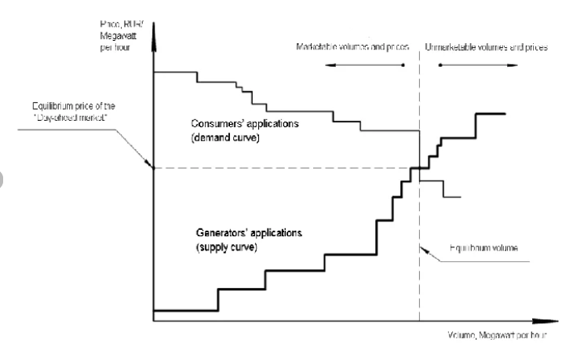
Day Ahead Auction for “Pay-by-Clear” Wholesale prices
Price per Megawatt
E.ON
Ecotricity
British Gas
Price of the day ahead market for 1 half hour period
Gas fired stns A,B,C,D
Suppliers Offers
=Demand Curve
Wind farm
Solar farm
Nuclear Stn B
Nuclear Stn A
Bids of Generators
= Supply Curve
N
Cumulative Megawatts
Notes:
Deriving the Day Ahead Clearing Price
1. The day before supply, buyers and sellers submit offers for half hourly (HH) trading periods. So up to 48 offers per day from any buyer or seller.
2. Sellers state the maximum MW they can deliver and the minimum price they will accept and buyers state the maximum MW they require and the maximum price they will pay.
4. These offers put in order of cheapest to dearest plotted cumulatively as the ‘supply curve’ and the ‘demand curve’ for every HH period.
5. The market price for each HH period is where the two curves intersect.
6. All units traded receive the same clearing price.
Its called “Pay by Clear” and it is transparent. Everyone can see what is going on.
Quirks
1. You would think that bilateral trades supplying 50% of demand would reduce the impact of gas prices on wholesale prices.
2. Small generators sell at fixed price to large generators who then trade in the auction.
3 generators on contracts for difference trade in the auction but get a fixed price

Slide 6
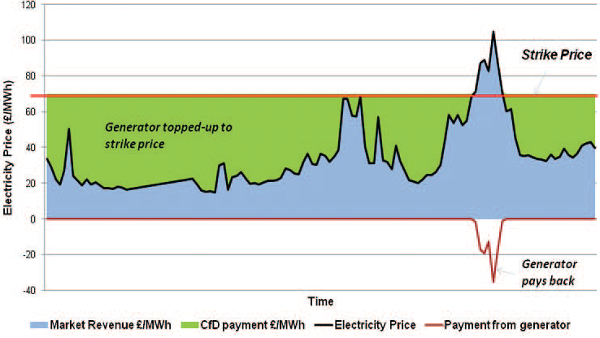
Contracts for Difference example
N
Notes:
1. Introduced in 2014 for new capital intense generators such as new Nuclear or Renewables
2. The Key feature of CfD is the Strike Price, agreed with government before the windfarm / Nuclear power Stn is built.
3. Contract for difference generators bid in the auction other wise they cannot generate but...
4. CfD generation had grown in recent years as shown in Next Slide and helps to escape from the effect of variable gas prices.

Slide 7
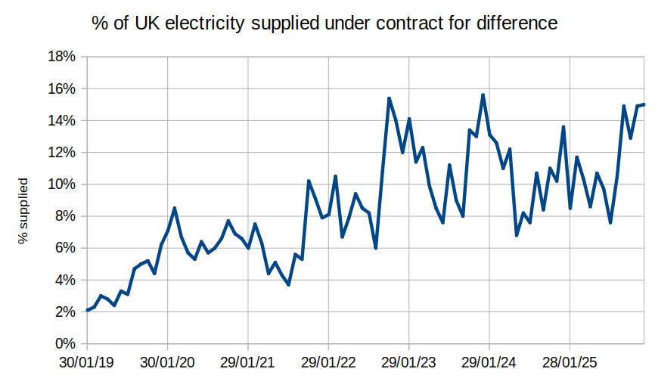
% of Uk electricity supplied via Contracts for Difference (CfD)
% of UK electricitysupplied

Slide 8
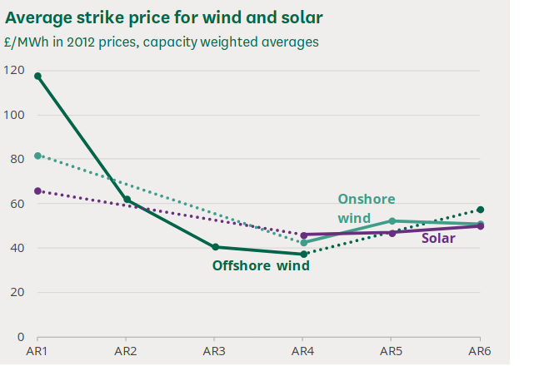
Allocation Round (AR) Dates and Timelines
AR1 (2014/15): October 2014 to March 2015.
AR2 (2017): March 2017 to September 2017.
AR3 (2019): May 2019 to September 2019.
AR4 (2021/22): December 2021 to July 2022.
AR5 (2023): March 2023 to September 2023.
AR6 (2024): March 2024 to September 2024.
2014-15 2017 2019 2021/22 2023 2024
https://researchbriefings.files.parliament.uk/documents/CBP-9871/CBP-9871.pdf

Slide 9
Pros & Cons of Pay-as-Clear
Pros
Efficiency & Transparency
Incentivises Low-Cost Generation
Encourages Truthful Bidding
Market Stability
Cons
Possible High Consumer Costs
Windfall Profits for low cost generators
https://researchbriefings.files.parliament.uk/documents/POST-PN-0694/POST-PN-0694.pdf
N
Notes:
Pros :
suppliers bid close to their marginal costs.
Incentivises building renewable and nuclear energy, which have low running costs .
Encourages Truthful Bidding: Generators have no incentive to bid above their actual cost, as it does not change the final clearing price they receive.
Market Stability: Provides a predictable, single clearing price that facilitates adequate supplies
Cons of Pay-as-Clear:
High Consumer Costs: When expensive sources like gas are the marginal (last) unit, all generators—including cheaper renewables—are paid the high gas price, increasing costs for consumers.
Windfall Profits: Low-cost generators (e.g., wind, solar, nuclear) may earn significant profits, because they are paid the high marginal price despite having lower production costs.

Slide 10
Alternatives to Pay-as-Clear
Pay as Bid*
might reduce consumer costs but it can lead to inefficient, greedy bidding behaviour.
Split Pay-as-Clear**
is being explored as a compromise to reduce extreme price spikes while maintaining efficiency.
* https://arxiv.org/pdf/2507.06035 ** https://www.emergentmind.com/topics/pay-as-clear-pac
Notes:
Pay-as-Clear vs. Alternatives:
While Pay-as-Bid (PB) is sometimes considered to reduce consumer costs, it can lead to inefficient, higher-risk bidding behaviour. Some regions are exploring Split Pay-as-Clear (SPaC) as a compromise to reduce extreme price spikes while maintaining efficiency.

Slide 11
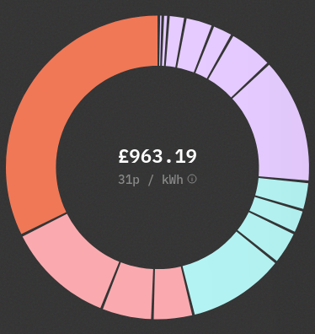
0.1% Remote highland power
0.3% Intensive industry support
2% Warm Home Discount
3% ECO, Energy efficiency
taxation
Benefits, Pension Credit
for low income households
2% Smart meters
Wholesale 33%
2025
5% VAT
14% Supplier costs & Margin
3% Capacity Market
2% Feed In Tariff
Distribution 12%
3% Contracts for Difference
Transmission 5%
11% Renewables Obligation taxation
Balancing 4%
Total 21%
https://www.electricitybills.uk/?utm_source=substack&utm_medium=email

Slide 12
Summary
There are 15 cost components in electricity bills, soon reducing to 13, saving about 14%.
The biggest component (33%) is creation of the electricity.
48 auctions per day determine the price of most of the electricity created, dominated by the price of gas fired power. The price achieved in each auction is paid to all generators irrespective of their bid price.

Slide 13
Summary
There are 15 cost components in electricity bills, soon reducing to 13, saving about 14%.
The biggest component (33%) is creation of the electricity.
48 auctions per day determine the price of most of the electricity created, dominated by the price of gas fired power. The price achieved in each auction is paid to all generators irrespective of their bid price.
There are other essential costs. Delivering the electricity (21%). Supplier costs (14%) & VAT. Subsidies and levies (26%) supporting low carbon and fuel poor are also added.
Contacts for Difference support deployment of a lot of low carbon generation and fix the price for about 12% of supply. More CfD is coming but it will be many years before the grid is entirely free of gas fired power, the main determinant of the auction price.

Slide 14
Thanks for listening.
Questions, in the chat please

